Slide 1


















Continuous Deployment
Introduction to CD
Build
Build
Auto
Auto
Auto
Auto
Commit
Continuous Delivery
Test
Commit
Continuous Deployment
Test
Deploy
Manual
Deploy
Auto

Slide 2




Deployment
Considerations
Compatibility
Backward Forward
Canary Testing
Deployment Consideration
Rollback
---> roll forward
Tools

Slide 3
Deployment
Challenges in Deployment
Deployment Process Waste
Build and operations teams waiting for documentation or fixes Testers waiting for “good” builds of the software
Development teams receiving bug reports weeks after the team has moved on to new functionality
Discovering, towards the end of the development process, that the application’s architecture will not support the system’s nonfunctional requirements
This leads to software that is undeployable because it has taken so long to get it into a production-like environment, and buggy because the feedback cycle between the development team and the testing and operations team is so long

Slide 4
Deployment
New Approach
End-to-End approach to delivering software
Deployment of Application should be easy & one click to go
A powerful feedback loop; rapid feedback on both the code and the deployment process
Lowering the risk of a release and transferring knowledge of the deployment process to the development team
Testing teams deploy builds into testing environments themselves, at the push of a button
Operations can deploy builds into staging and production environments at the push of a button
Developers can see which builds have been through which stages in the release process, and what problems were found
Automate Build, Deploy, Test and Release System
Note: As a result, everybody in the delivery process gets two things: access to the things they need when they need them, and visibility into the release process to improve feedback so that bottlenecks can be identified, optimized, and removed.
This leads to a delivery process which is not only faster but also safer

Slide 5
Deployment Pipeline
What is Deployment Pipeline
An automated manifestation of your process for getting software from version control into the production
Change
Build
Test
Deploy
Increase the collaboration between many individuals

Slide 6
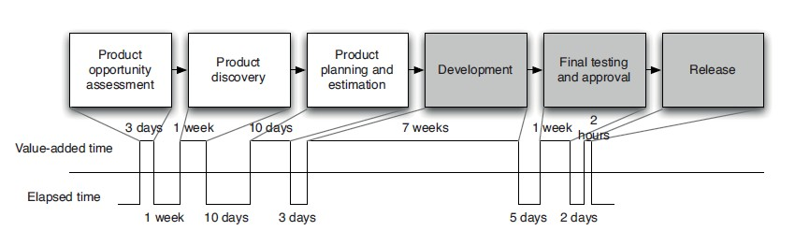
Deployment Pipeline
Value Stream Map of a Product Creation
A high-level value stream map for the creation of a new product

Slide 7


Structure of Deployment Pipeline
Expected steps to be followed
The input to the pipeline is a particular revision in version control
Every change creates a build
It pass through a sequence of tests and challenges to, its viability as a production release

Slide 8
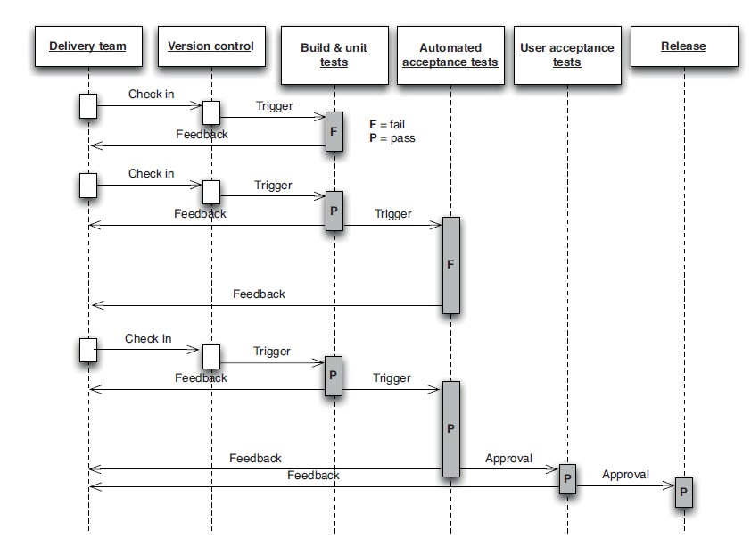
Structure of Deployment Pipeline
Example

Slide 9
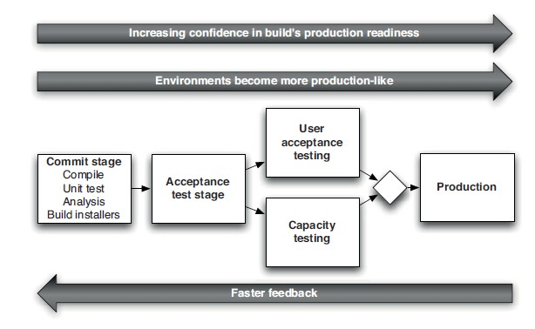
Structure of Deployment Pipeline
Broad Overview

Slide 10
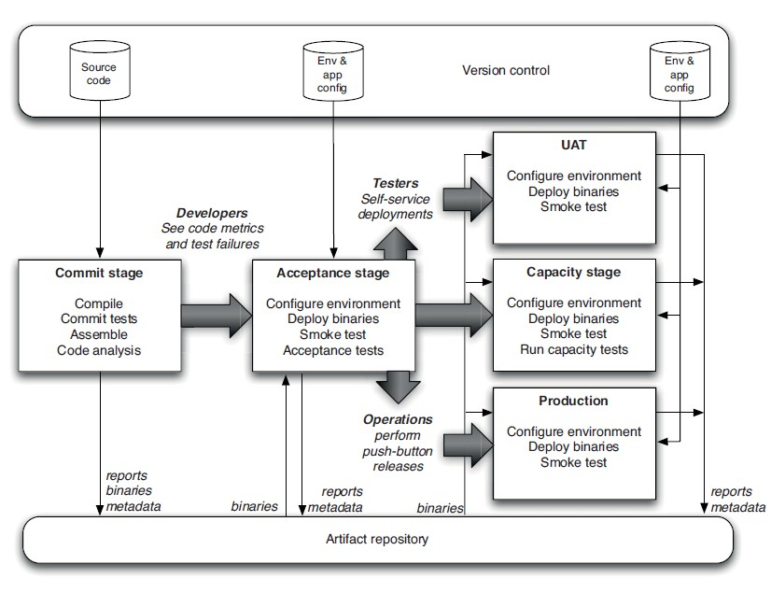
Deployment Pipeline
Basic Deployment Pipeline

Slide 11
Basic Deployment Pipeline
Outcome
The ultimate purpose of all this is to get feedback as fast as possible
To make the feedback cycle fast
To be able to see which build is deployed into which environment and
Which stages in your pipeline each build has passed
Note: It means that if you see a problem in the acceptance tests (for example), you can immediately find out which changes were checked into version control that resulted in the acceptance tests failing

Slide 12


Deployment Pipeline
Antipatterns of dealing with Binaries
The source code will be compiled repeatedly in different contexts: during the commit process, again at acceptance test time, again for capacity testing, and often once for each separate deployment target

Slide 13
Antipatterns of dealing with Binaries
Violates two Principles
Efficiency of Deployment pipeline
Recompiling violates this principle because it takes time, especially in large systems
Delayed feedback
Always build upon foundations
The binaries that get deployed into production should be
exactly the same as those that went through the acceptance test process
Recreation of binaries violates this principle

Slide 14
Deployment Pipeline
Deployment Pipeline Practices
Only Build Your Binaries Once
Deploy the Same Way to Every Environment
Note: Using the same script to deploy to production that you use to deploy to development environments is a fantastic way to prevent the “it works on my machine” syndrome
Smoke-Test Your Deployments
Deploy into a Copy of Production
Each Change Should Propagate through the Pipeline Instantly
Intelligent pipeline scheduling
If Any Part of the Pipeline Fails, Stop the Line

Slide 15
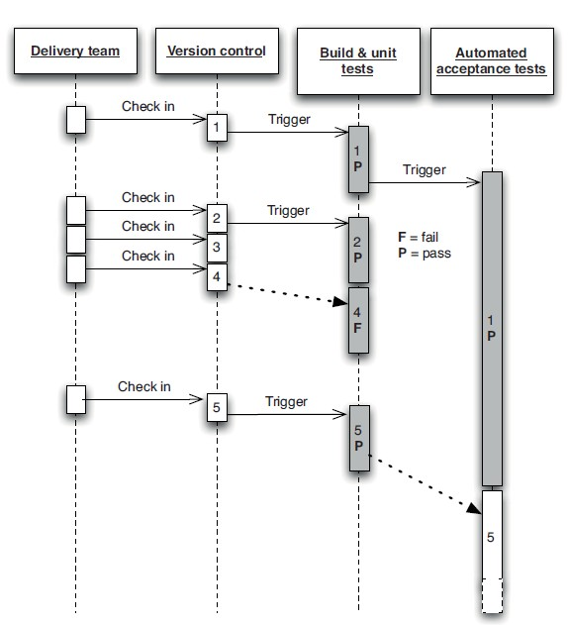
Deployment Pipeline Practices
Intelligent scheduling
Intelligent scheduling is crucial to implementing a deployment pipeline

Slide 16
Deployment Pipeline
Stages in Deployment Pipeline
The Commit Stage
The Automated Acceptance Gate
Subsequent Test Stages
Preparing to Release

Slide 17
Preparing to Release
Release Plan
Have a release plan that is created and maintained by everybody involved in delivering the software, including developers and testers, as well as operations, infrastructure, and support personnel
Minimize the effect of people making mistakes by automating as much of the process as possible
Practice the procedure often in production-like environments, so you can debug the process and the technology supporting it
Have the ability to back out a release if things don’t go according to plan
Have a strategy for migrating configuration and production data as part of the upgrade and rollback processes
Note: Goal is a completely automated release process, Releasing should be as simple as choosing a version of the application to release and pressing a button and Backing out should be just as simple

Slide 18
Human Free Deployments
Automating Deployment and Release
Reduces issues due manual mistakes
Audit logs

Slide 19
Human Free Deployments
Benefits
With automated deployment and release, the process of delivery becomes available to everyone
Developers, testers, and operations teams no longer need to rely on ticketing systems and email threads to get builds deployed so they can gather feedback on the production readiness of the system
Testers can decide which version of the system they want in their test environment without needing to be technical experts themselves, nor relying on the availability of such expertise to make the deployment
Sales people can access the latest version of the application with the killer feature that will swing the deal with a client
An important reason for the reduction in risk is the degree to which the process of release itself is rehearsed, tested, and perfected
Since you use the same process to deploy your system to each of your environments and to release it, the deployment process is tested very frequently—perhaps many times a day

Slide 20
Implementing a Deployment Pipeline
The steps to implement a deployment pipeline
Model your value stream and create a walking skeleton
Automate the build and deployment process
Automate unit tests and code analysis
Automate acceptance tests
Automate releases

Slide 21
Deployment Consideration
Rolling Back Deployments
It is essential to roll back a deployment in case it goes wrong
As, debugging problems in a running production environment is almost certain to result in late nights
a way to restore service to your users when things go wrong, so you can debug the failure in the comfort of normal working hours
There are several methods of performing a rollback
blue-green deployments and canary releasing can also be used to perform zero-downtime releases and rollbacks

Slide 22
Rolling Back Deployments
Rolling Back Deployments Constraints
Data : If your release process makes changes to your data, it can be hard to roll back
There are two general principles you should follow when creating a plan for rolling back a release
Ensure that the state of your production system, including databases and state held on the filesystem, is backed up before doing a release
The second is to practice your rollback plan, including restoring from the backup or migrating the database back before every release to make sure it works

Slide 23
Deployments
Zero-Downtime Releases
Hot deployment, in which the process of switching users from one release to another happens nearly instantaneously
It must also be possible to back users out to the previous version nearly instantaneously too, if something goes wrong
The key to zero-downtime releases is decoupling the various parts of the release process so they can happen independently as far as possible

Slide 24

Deployment
Deployment Strategies
Blue-Green Deployments
Canary Releasing
Rolling upgrade

Slide 25
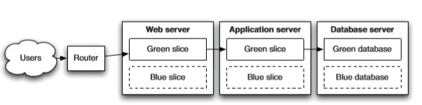
Blue-Green Deployments
Introduction
This is one of the most powerful techniques we know for managing releases
The idea is to have two identical versions of your production environment, which we’ll call blue and green

Slide 26

Blue-Green Deployments
Challenges
It is usually not possible to switch over directly from the green database to the blue database because it takes time to migrate the data from one release to the next if there are schema changes
Solutions:
Put the application into read-only mode shortly before switchover
Another approach is to design your application so that you can migrate the database independently of the upgrade process

Slide 27




Blue-Green Deployments
Setup
blue and green environments can be completely separate replicas of each other
you can only afford a single production environment
have two copies of your application running side by side on the same environment (with its own resources
like port, filesystem etc.,)
Use virtualization

Slide 28
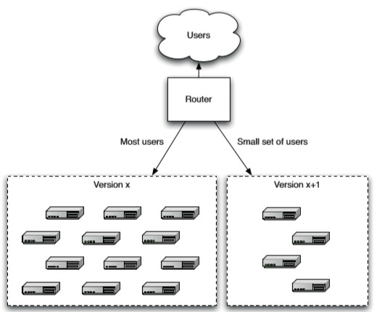
Canary Releasing
Introduction
Involves rolling out a new version of an application to a subset of the production servers to get fast feedback
Like a canary in a coal mine, this quickly uncovers any problems with the new version without impacting the majority of users

Slide 29
Canary Releasing
Benefits
It makes rolling back easy: Just stop routing users to the bad version, and you can investigate the logs at your freedom
You can use it for A/B testing by routing some users to the new version and some to the old version
Some companies measure the usage of new features, and kill them if not enough people use them
Others measure the actual revenue generated by the new version, and roll back if the revenue for the new version is lower
You can check if the application meets capacity requirements by gradually ramping up the load, slowly routing more and more users to the application and measuring the application’s response time and metrics like CPU usage, I/O, and memory usage, and watching for exceptions in logs

Slide 30
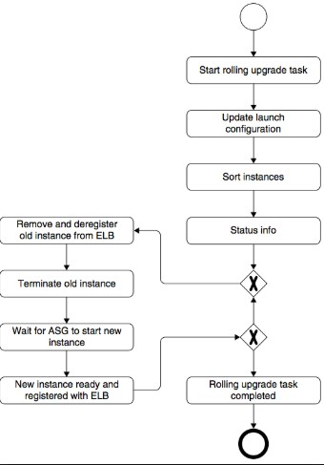
Rolling upgrade
Introduction
A rolling upgrade consists of deploying a small number of new version systems at a time directly to the production environment
In this deployment simultaneously you turn off the old version system
Before you remove the original system; make sure the new version system is serving the purpose
ELB – Elastic Load Balance of AWS Cloud

Slide 31
Rolling upgrade
Benefits
Cost Effective
Risk Effective

Slide 32
Emergency Fixes
Best Practice for Emergency Fixes
Run every emergency fix through your standard deployment pipeline
You should always consider how many people the defect affects, how often it occurs, and how severe the defect is in terms of its impact on users
Some considerations to take into account when dealing with a defect in production:
Never do them late at night, and always pair with somebody else
Make sure you have tested your emergency fix process
Only under extreme circumstances bypass the usual process for making changes to your application
Make sure you have tested making an emergency fix using your staging environment
Sometimes it’s better to roll back to the previous version than to deploy a fix, do some analysis to work out what the best solution is

Slide 33
Deployment
Tips and Tricks
The People Who Do the Deployment Should Be Involved in Creating the Deployment Process
Things Go Better When Development and Operations Are Friends
Log Deployment Activities
If your deployment process isn’t completely automated, including the provisioning of environments, it is important to log all the files that your automated deployment process copies or creates
Don’t Delete the Old Files, Move Them
Deployment Is the Whole Team’s Responsibility
A “build and deployment expert” is an antipattern. Every member of the team should know how to deploy, and every member of the team should know how to maintain the deployment scripts

